Slide 1
NAT

Slide 2
Private Network
Private IP network is an IP network that is not directly connected to the Internet
IP addresses in a private network can be assigned arbitrarily.
Not registered and not guaranteed to be globally unique
Generally, private networks use addresses from the following experimental address ranges (non-routable addresses):
10.0.0.0 – 10.255.255.255
172.16.0.0 – 172.31.255.255
192.168.0.0 – 192.168.255.255

Slide 3
Private Addresses

Slide 4
Network Address Translation (NAT)
NAT is a router function where IP addresses (and possibly port numbers) of IP datagrams are replaced at the boundary of a private network
NAT is a method that enables hosts on private networks to communicate with hosts on the Internet
NAT is run on routers that connect private networks to the public Internet, to replace the IP address-port pair of an IP packet with another IP address-port pair.

Slide 5
Basic operation of NAT
NAT device has address translation table

Slide 6
Pooling of IP addresses
Scenario: Corporate network has many hosts but only a small number of public IP addresses
NAT solution:
Corporate network is managed with a private address space
NAT device, located at the boundary between the corporate network and the public Internet, manages a pool of public IP addresses
When a host from the corporate network sends an IP datagram to a host in the public Internet, the NAT device picks a public IP address from the address pool, and binds this address to the private address of the host

Slide 7
Pooling of IP addresses

Slide 8
Supporting migration between network service providers
Scenario: In CIDR, the IP addresses in a corporate network are obtained from the service provider. Changing the service provider requires changing all IP addresses in the network.
NAT solution:
Assign private addresses to the hosts of the corporate network
NAT device has static address translation entries which bind the private address of a host to the public address.
Migration to a new network service provider merely requires an update of the NAT device. The migration is not noticeable to the hosts on the network.
Note:
The difference to the use of NAT with IP address pooling is that the mapping of public and private IP addresses is static.

Slide 9
Supporting migration between network service providers

Slide 10
IP masquerading
Also called: Network address and port translation (NAPT), port address translation (PAT).
Scenario: Single public IP address is mapped to multiple hosts in a private network.
NAT solution:
Assign private addresses to the hosts of the corporate network
NAT device modifies the port numbers for outgoing traffic

Slide 11
IP masquerading

Slide 12


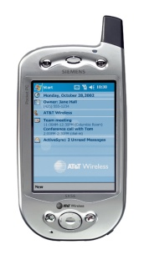
Mobile IP

Slide 13
What is Mobile IP?
Mobile IP stands for Mobile Internet Protocol
A wireless connection to the Internet
Designed to support host mobility
Stay connected regardless of location without changing IP address

Slide 14
Definitions
Mobile Node
A node/device that changes its point of attachment to the Internet
Home Agent
A router in the home network that communicates with the mobile node
Foreign Agent
A router in a foreign network that delivers information between mobile node and its home agent
Care-of-Address
Mobile Node’s current IP address
Correspondent Node
Node/device that is communicating with the mobile node (i.e. web server)

Slide 15
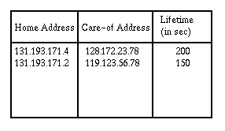
How does Mobile IP work?
Each mobile node has two IP addresses
- Permanent home address
- Care-of Address
Home Agent maintains a mobility binding table

Slide 16
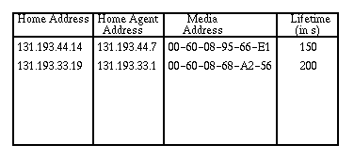
How does Mobile IP work? (Cont’d)
Foreign Agent contains a visitor list

Slide 17
How does Mobile IP work? (Cont’d)
What will happen when a packet is sent to the mobile node that is not attached to its home network?
Home agent forwards the packet to the care-of address of the mobile node using the binding table
Encapsulation
- Home agent constructs new IP header with care-of address
- Original IP address in payload

Slide 18
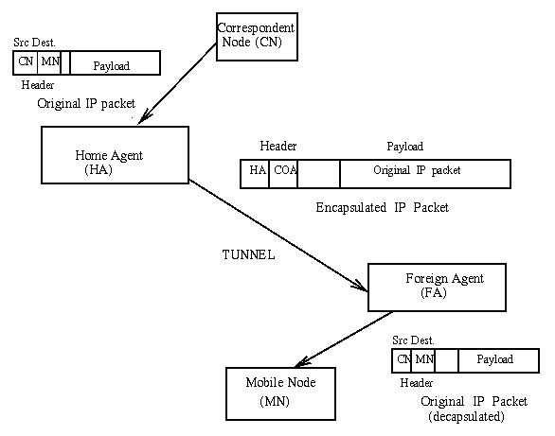
How does Mobile IP work? (Cont’d)
Foreign agent restores the original IP address from the payload
Foreign agent consults the visitor list for mobile node
Packet is then forward to the mobile node through the media address

Slide 19
How does Mobile IP work? (Cont’d)
What will happen when mobile node tries to send a packet?
Packets are sent to the foreign agent
Foreign agent sends the packets using normal IP routing

Slide 20
Agent Discovery
How does the mobility binding table and the visitor list get updated?
Agent periodically broadcast its present by sending Agent advertisement message
Mobile node sends Agent Solicitation message

Slide 21
Registration
What will happen when the mobile node wants to register with the foreign agent?
Mobile node sends a registration request message to the foreign agent
Foreign agent then sends a registration request message to the home agent
Home agent updates the mobility binding table and send an acknowledgement back to the foreign agent
Foreign agent then updates the visitor list and send an acknowledgement back to the mobile node

Slide 22
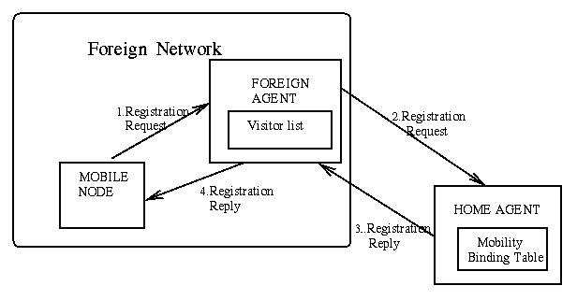
Registration (Cont’d)

Slide 23
Summary
Mobile IP has no geographical limitation
No need to change current IP address format or router implementation
Mobile IP enables mobile connection to network
The future is wireless!

